Slide 1
Introduction to Programming
Class 3, 6 September 2016
Livia Santos

Slide 2
Goals:
Goal 1: You will know how to write and execute a simple JavaScript program.
Goal 2: You will understand what an algorithm is.
Goal 3: You will know how to approach a programming task with others and on your own.
Vocabulary:
Algorithm Flowchart Function Variable String Comment Concatenation Escape Character
Code:
alert(string)
prompt(string)
var
//Comment
string.length
\”
\n

Slide 3
What makes a Javascript program?
Look at Weather.html
What looks familiar?
What looks strange?

Slide 4
What makes a JavaScript program?
simpleApp.html
What is common to weather.html and simpleApp.html?
Notes:
<script> </script>
;
//comments
“string”

Slide 5
Write your first program!
In sublime, open unit1/myFirstApp.html
Write your first program that creates two alert boxes with a joke like:
(alert 1) Q: What goes up and down but does not move?
(alert 2) A: Stairs

Slide 6
CHALLENGE!
Open only one computer, give to Pilot 1
Pilot 1: Create an empty template for an app called redirect.html
Pilot 2: Make the program tell the user using an alert box that “you are now being redirected to the American School in London website.”
Pilot 3: Open the ASL website using the correct address (http://www.asl.org) and the code
window.open(“address”);

Slide 7
Algorithm
A series of finite steps that will solve a problem.

Slide 8
Task: MAKE PANCAKES!

Slide 9
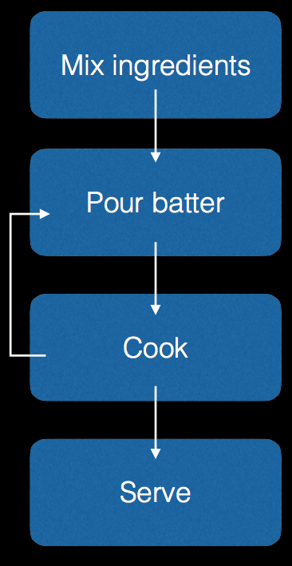
Method
Sift the flour, baking powder, salt and caster sugar into a large bowl. In a separate bowl or jug, lightly whisk together the milk and egg, then whisk in the melted butter.
Pour the milk mixture into the flour mixture and, using a fork, beat until you have a smooth batter. Any lumps will soon disappear with a little mixing. Let the batter stand for a few minutes.
Heat a non-stick frying pan over a medium heat and add a knob of butter. When it's melted, add a ladle of batter (or two if your frying pan is big enough to cook two pancakes at the same time). It will seem very thick but this is how it should be. Wait until the top of the pancake begins to bubble, then turn it over and cook until both sides are golden brown and the pancake has risen to about 1cm (1⁄2in) thick.
Repeat until all the batter is used up. You can keep the pancakes warm in a low oven, but they taste best fresh out the pan.
Serve with lashings of real maple syrup and extra butter if you like.

Slide 10
FLOWCHART

Slide 11
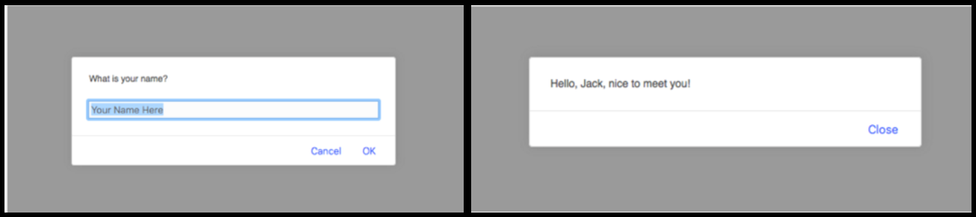
Task01– Saying Hello
Create a program called Task01-SayingHello.html that prompts for your name and prints a greeting using your name.
With your partner, write the algorithm in English

Slide 12
With your partner, write the algorithm in English
Prompt the user for his or her name.
Display the message

Slide 13
Algorithm/Pseudo-code
Prompt the user for his or her name.
1a. Remember the user’s name
1b. Construct the message with the user name and save it.
2. Display the message
With your partner, write a flowchart

Slide 14
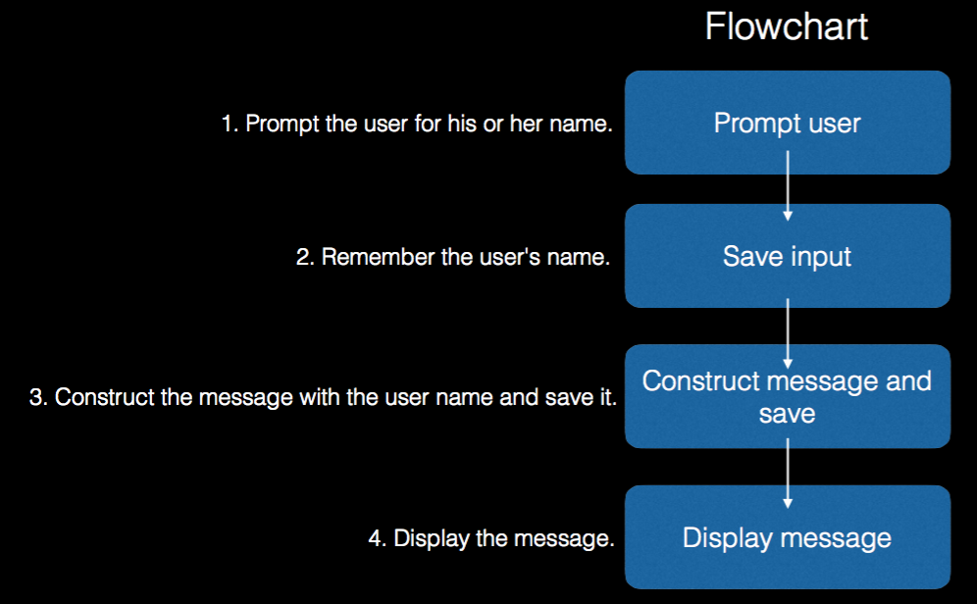

Slide 15
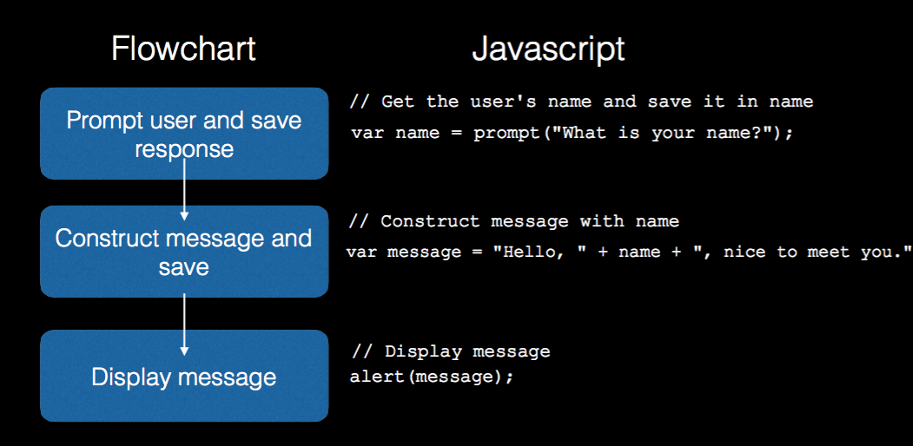

Slide 16
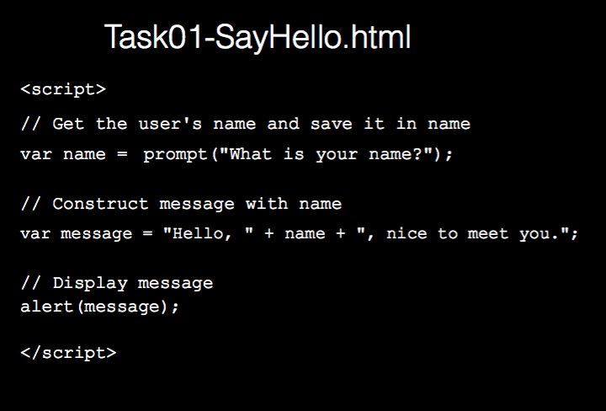

Slide 17
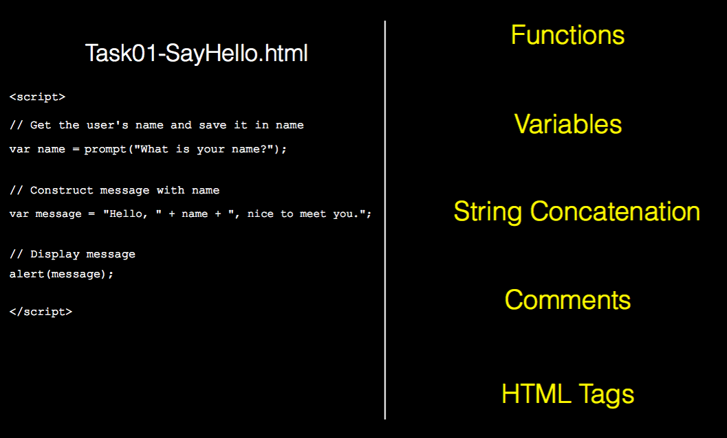

Slide 18
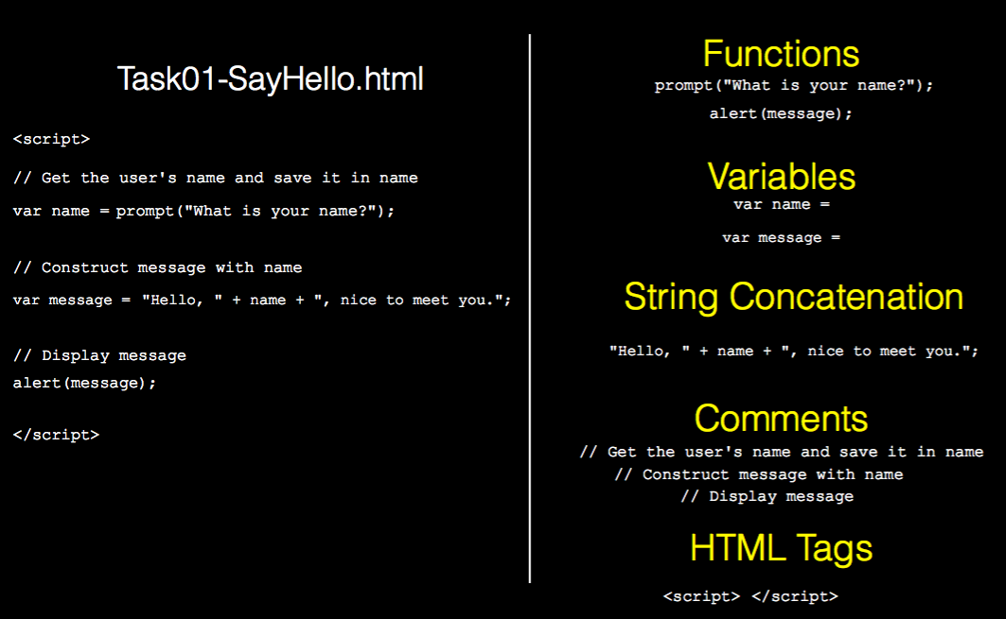

Slide 19
Read Task02-CountingNumberOfCharacters.
Write an algorithm (pseudo-code or flowchart)

Slide 20
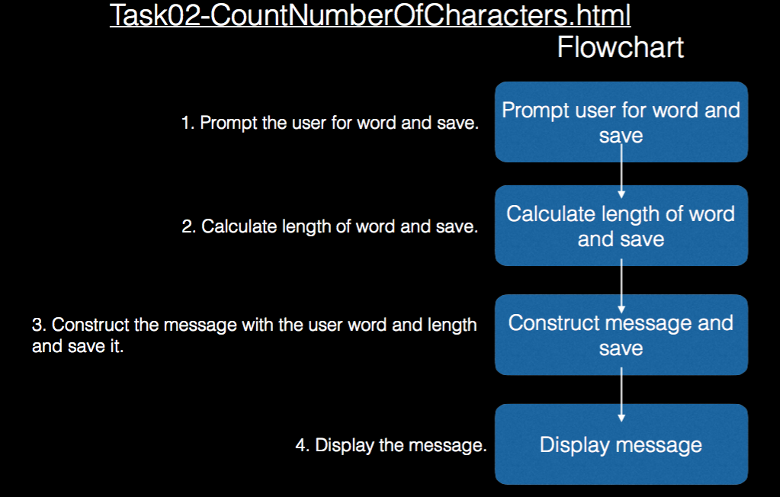

Slide 21
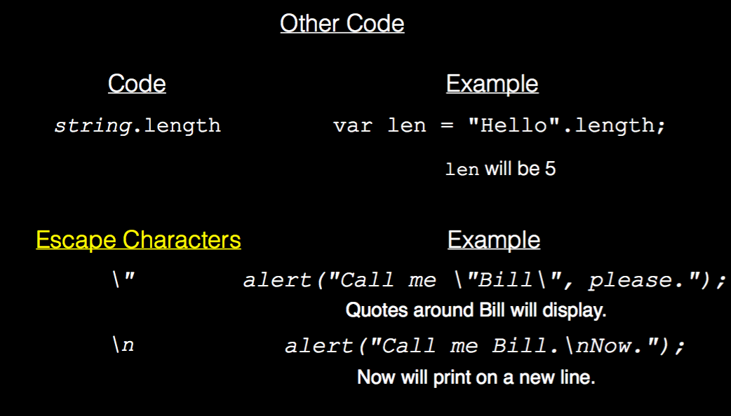

Slide 22
Goals:
Goal 1: You will know how to write and execute a simple JavaScript program.
Goal 2: You will understand what an algorithm is.
Goal 3: You will know how to approach a programming task with others and on your own.
Vocabulary:
Algorithm Flowchart Function Variable String Comment Concatenation Escape Character
Code:
alert(string)
prompt(string)
var
//Comment
string.length
\”
\n

